Slide 1
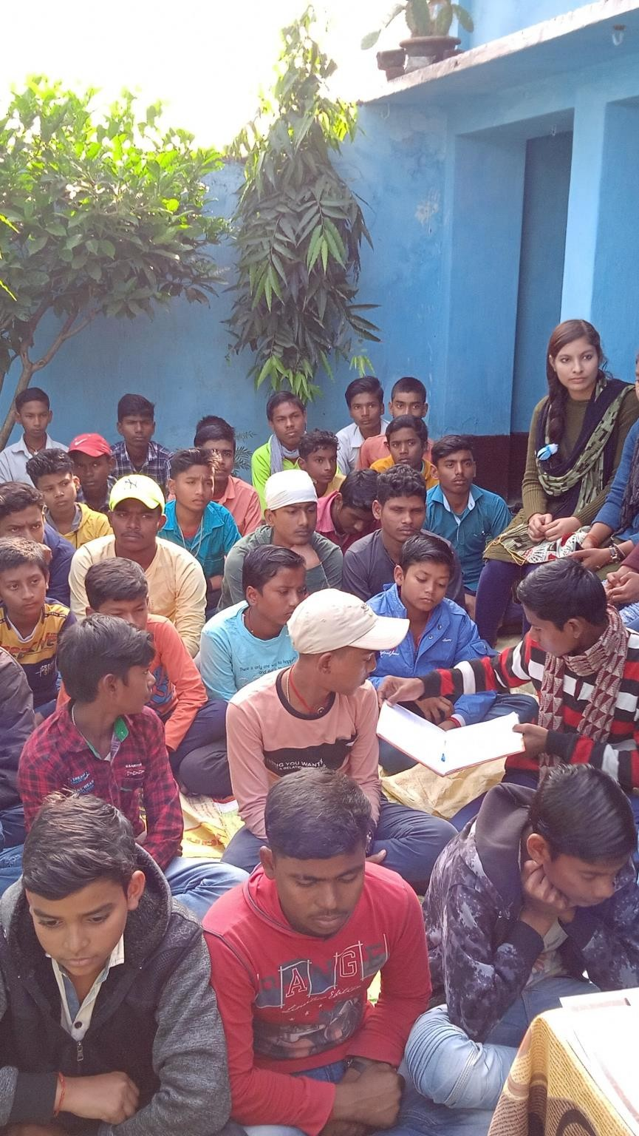

RFF is 1 now!
www.ruralfuture.in
ANNUAL REPORT
December 2021

Slide 2
“Completing one year is always special and being one is a matter of joy and pride for us. As a child , we are finding opportunities to learn and explore. Meanwhile, we will continue to grow — in size, in areas within our reach for rural communities in the years ahead.”
ORIGIN
Rural Future Foundation (RFF) began in 2020 with the single-minded focus of empowering Rural India. COVID19 pandemic has affected lives and livelihoods across all segment but rural population has been severely affected. The pandemic has triggered a massive reverse migration from the urban to rural areas in large parts of the country. Many migrant families who trekked home under the most difficult circumstances would have both short and long-run effect. India has witnessed globalization, information technology and data technology revolution in last three decades but rural population didn’t get much benefit of these revolution.

Slide 3

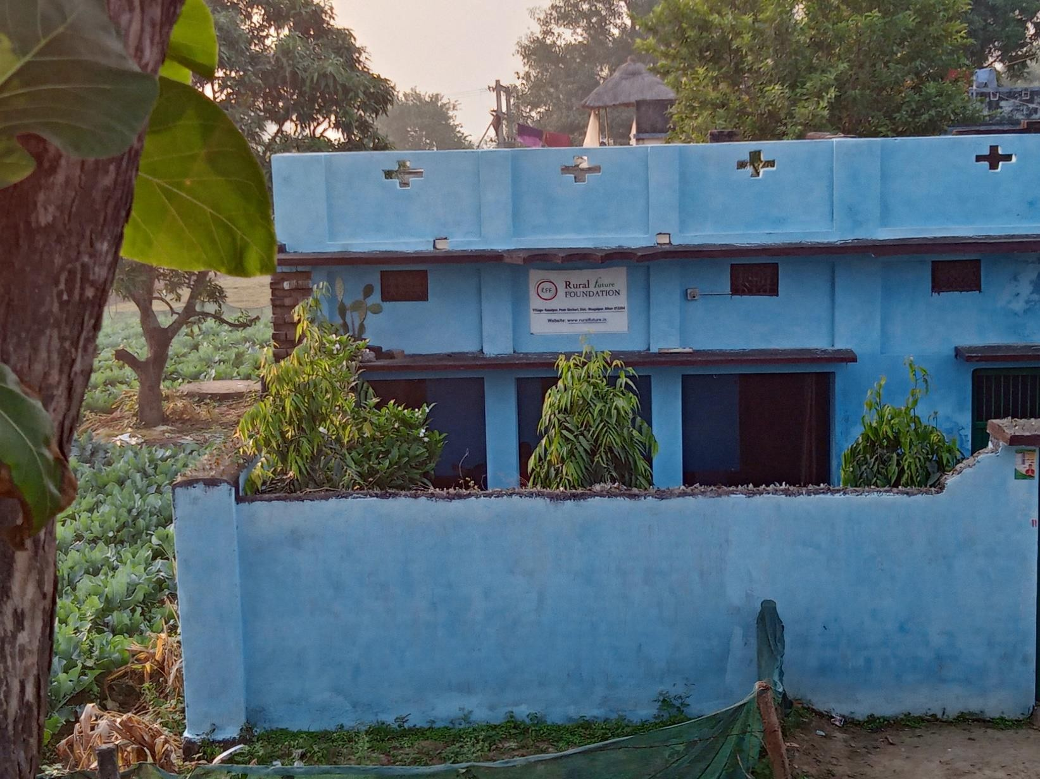
A brief Journey Dec 2020- Dec 2021
The main aim of Rural Future Foundation is to level the playing field by enabling rural population to leverage innovation and technology to grow and compete more effectively. Rural Future Foundation was registered as a Charitable Trust on December 17, 2020 in Delhi. To begin with, we as a foundation decided to focus on education and therefore came up with first rural library.’ The foundation was launched first initiative on 14th August 2021.
Since then we have also started live webinar sessions on various topics related to livelihood, carrier counseling etc. for rural population. We have also started many activities for rural population to inclusive growth and opportunities. One clear aim in all our minds was to create significant impact through the foundation. While it has been only 4 months since we launched the foundation’s activity, we have already created impressive progress. We have had around 1,000 people visited our library, more than 100 students attended our webinars.
RFF has also conducted Rural Quiz Competition 2021. Around 300 students from more than 10 villages in near by area participated into three group i.e. Class 7-8, 8-9 & 9-10.
The foundation envisioned to provide technology and information based innovative solutions to the challenges that affect the rural population in five areas; Healthcare, Education, Economic Development, Environment and Rural Research. India, with the largest rural population in the world, is experiencing an increasing urban-rural divide. Thus, our focus is enabling them to be self-reliant and prevent migration to urban centers through all-round development by improving the living conditions of underserved citizens through technology and data driven decision making.
All that we have achieved and all that we plan to do over the next couple of years would not be possible without your encouragement and generous support.We would like to thank each and every one of you wholeheartedly and hope for your continued support in the years to come.

Slide 4
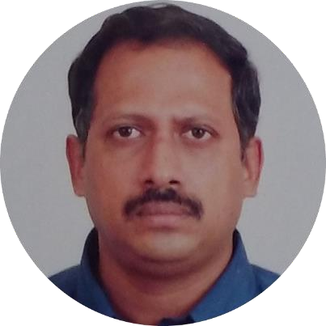
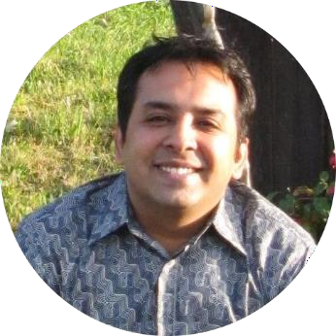
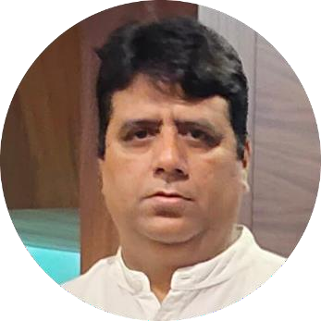
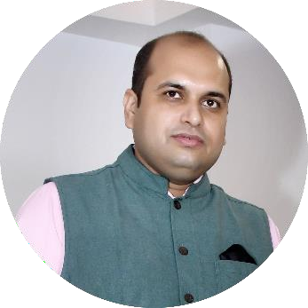
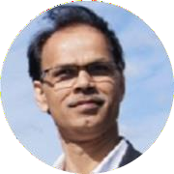
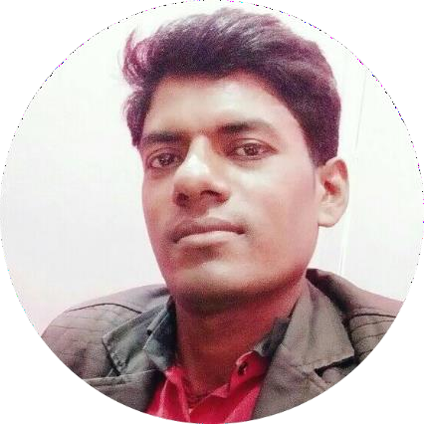
Board of Trustee
Dr. Amit Nair
Trustee & Chairperson
A development professional with his research associations and advisory roles to many international development agencies such as World Bank, Water Aid, UNICEF, UN-OPS, TAHAL Engineering Consultants Israel, EAWAG (SANDEC) Switzerland, Development Alternatives, DFID, IAEA and HiVos Foundation for more than two decades. He has published 12 publications in his credit and manual for Water Safety Plan, WSP-SA, Review International paper, 2015. He has been also awarded a fellowship by National Educational Test at Master’s Level from UGC, Delhi. Dr. Nair received a B.Sc (Hon), M.Sc and PhD on pesticide behaviour & monitoring – radiolabel from University of Delhi as well as Post-doctoral work from University of Delhi.
Mr. Amit Arora
Trustee & Advisor
A senior M&E Specialist with solid experience in Monitoring and Evaluation, development of the logical framework, Data analysis and conducting impact Evaluations, currently working with the UNDP office of Iraq as an International M&E Adviser in the Disarmament, demobilization and reintegration (DDR) program under Rule of Law. He supported many countries in designing M&E Systems for Environment, Employment, Agriculture and Health through a tailored capacity-building approach. He has worked as a Strategic Advisor to many public institutions in African Countries and international organizations within Rwanda, Côte d’Ivoire, India, Laos, Iraq, Maldives, Cambodia, Mongolia and Nepal. He has experience in working with various donors like AFDB, ADB, USAID, UNDP, SIDA, GIZ, BTC, World Bank, UNICEF and EU.Mr. Arora has earned his Master of Management Studies in Operation Management from the Jamia Millia University and a Master in Demography from the International Institute of Population Science.
Mr. Ganesh Bhatt
Trustee
A social development professional and hard core implementer, currently Heading Department of Programmes Management at Global Cancer Concern India (GCCI). He has been appearing as a guest and an expert in various national-level events on the programmes related to the social issues. He has also written articles and book reviews on social issues. Mr. Bhatt holds a Master degree in Social Work with specialization in Health and Community
Mr. Santosh Choudhary
Trustee
A social development professional with his substantial skills of project implementation and data science in social sector brings considerable experience and expertise to Organization, along with his work associations to many other non-profits. Mr. Choudhary holds a Master degree in Business Administration and Bachelor & Master degree in Computer Application
Development
Team
Mr. Rajive Acharya
Strategic Advisor
An entrepreneur, thinker and Managing Director of mfore: An impact enterprise based at Finland
Mr. Anuj Patel
Field Operation Coordinator
A law Graduate and passionate social worker.

Slide 5

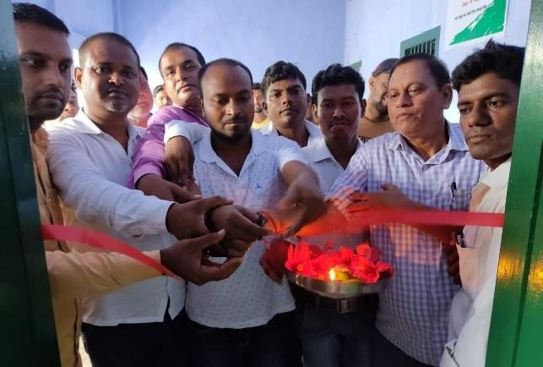
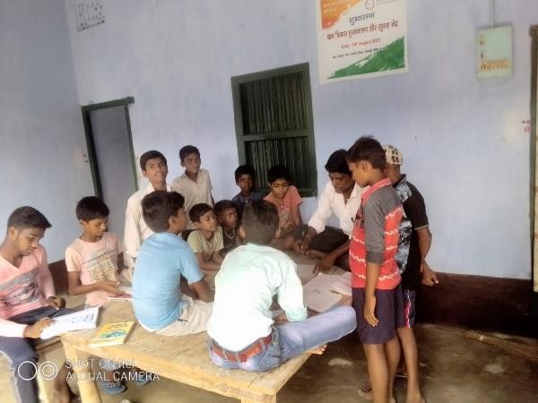
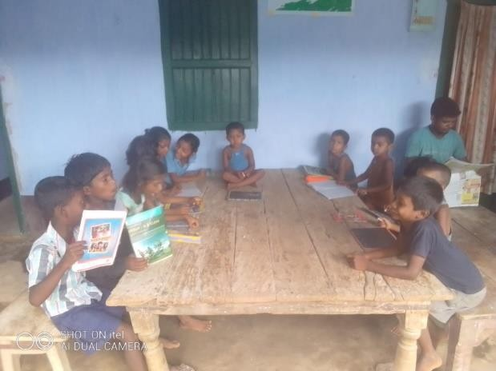
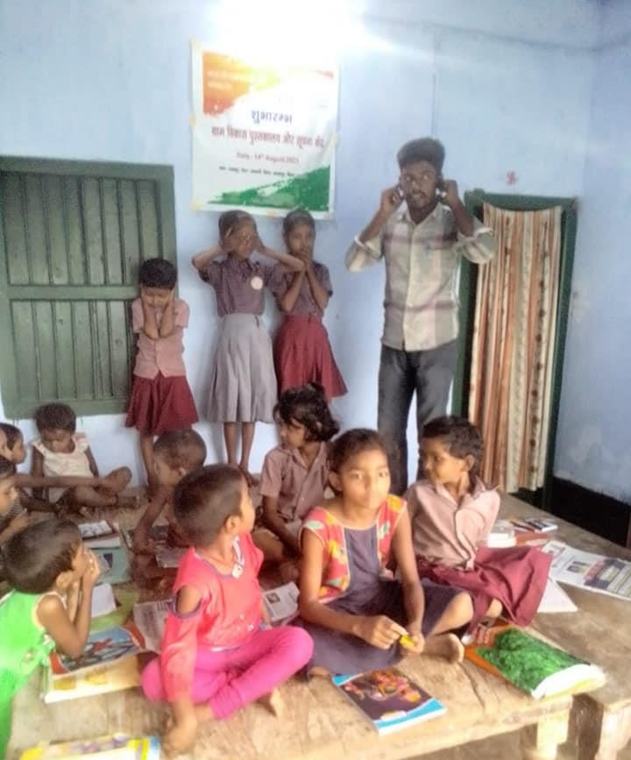
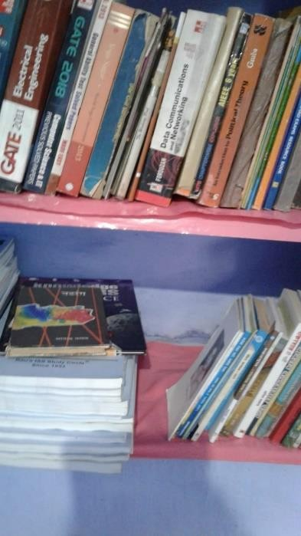
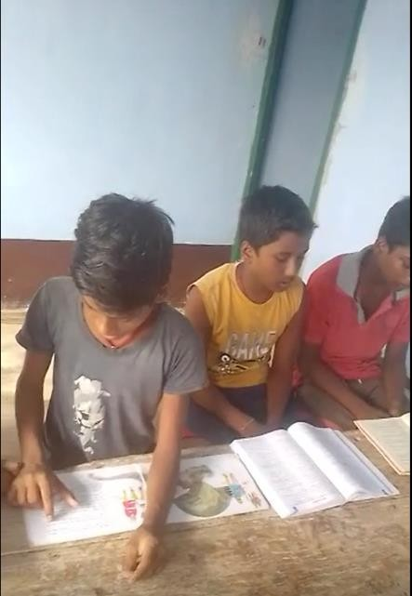
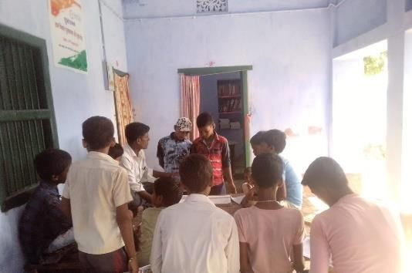
Initiatives
1Library and Information Centre
We
have established a
library center at
and information Operation
Field
Office in Rasalpur, Ekchari
Village, Bihar.
Bhagalpur
District, It will provide
to rural
and students,
opportunity
population
ensuring freedom and equal
access to knowledge to
information and
and
educate
enlighten them. It is helping rural community to break stereotype, what they should learning.

Slide 6


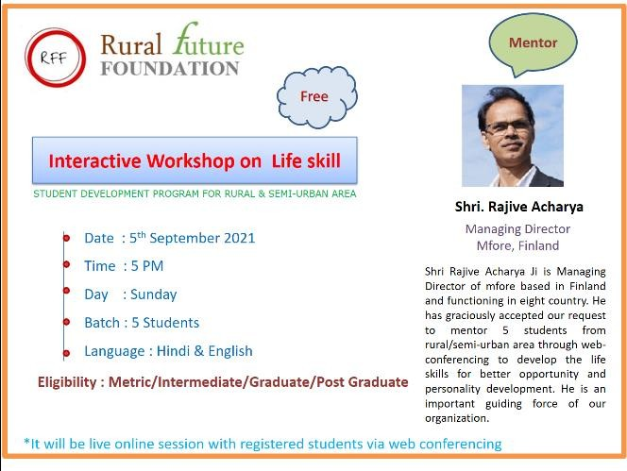
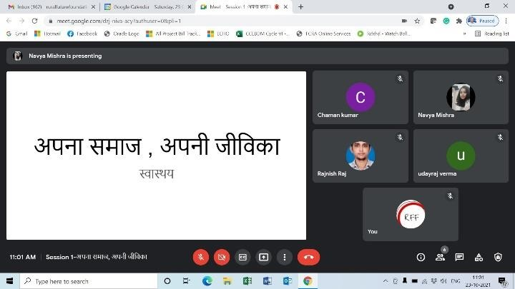
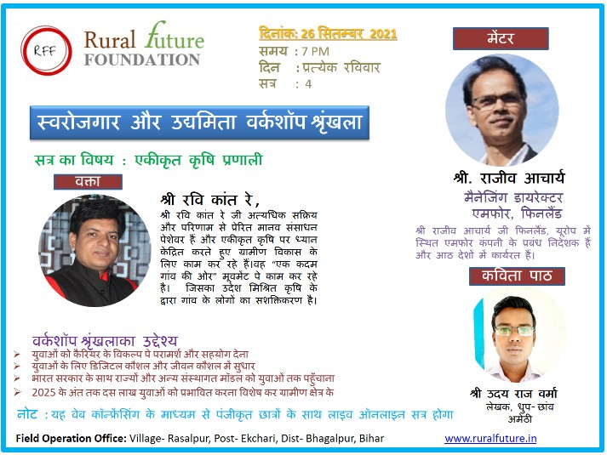

2 Webinars
Rural India is witnessing huge surge of smart phone users in near past. Training related to livelihood, life skills and soft skills was given by Information center using the web conferencing to maximize reach and opportunity in remote places. We have conducted 5 webinars till now and reached more than 100 rural students.

Slide 7

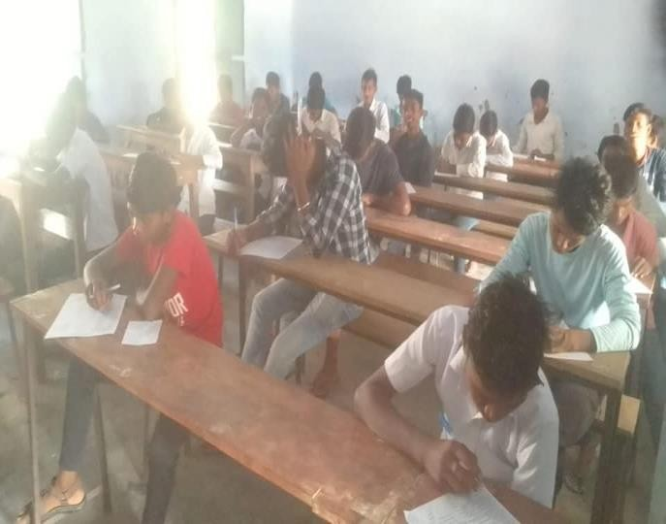
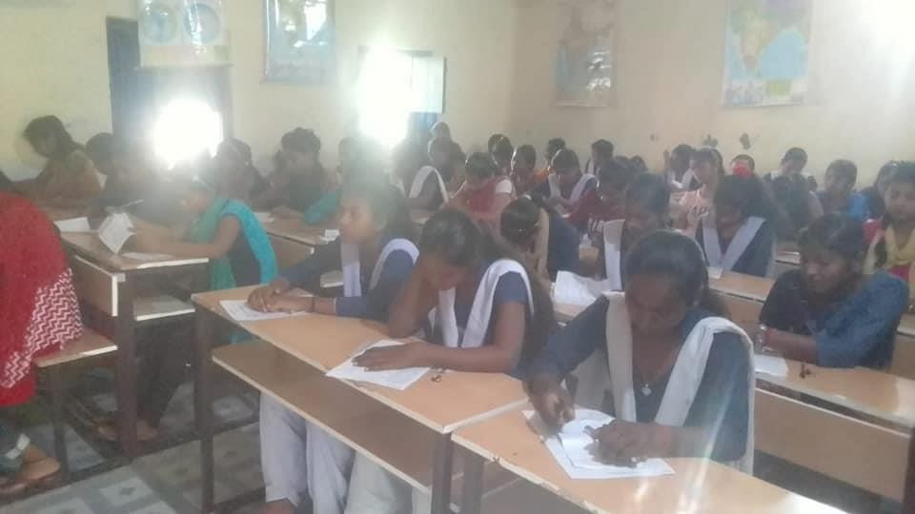
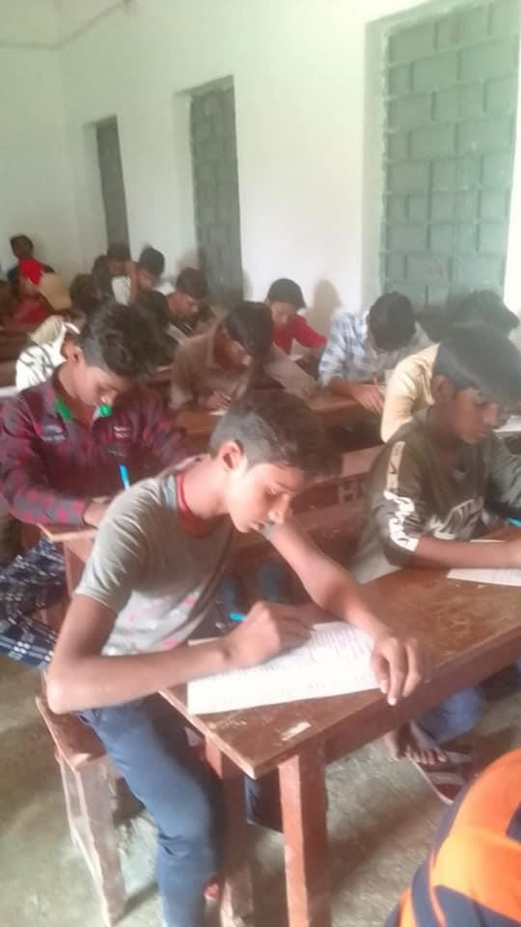
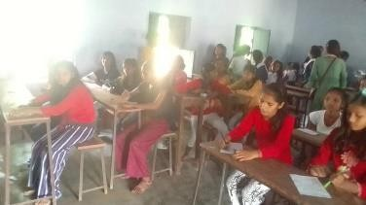
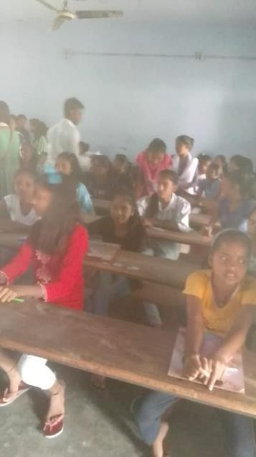
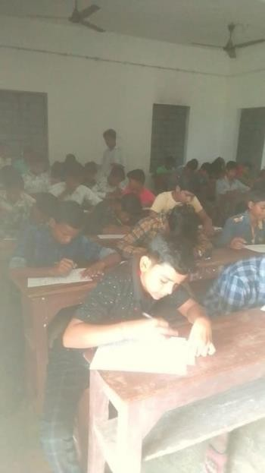
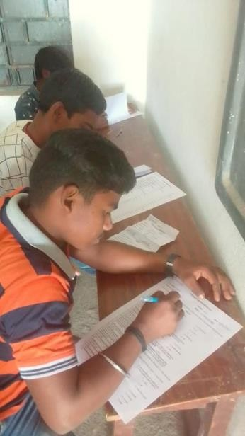
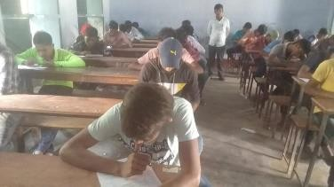

3Rural Quiz 2021 Competition
A Quiz Competition was organized for the 3 level of students which covered the areas of Science, Maths, Social Science and General Knowledge. There were a total of 3 groups i.e. Group A ( Class 11-12), Group B ( Class 9-10) and Group C ( Class 7-8)
Quiz exam was conducted at Ekchari High School, Bhagalpur on 31st October 2021, where 300 rural students appeared in exam from 10 villages.

Slide 8

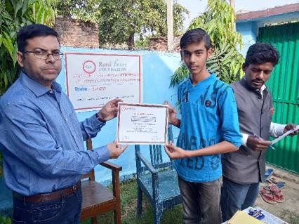
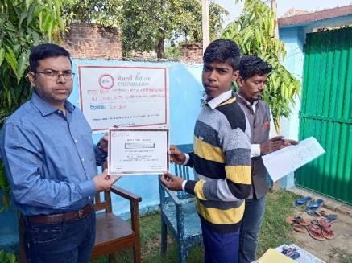
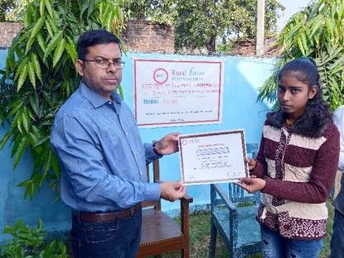
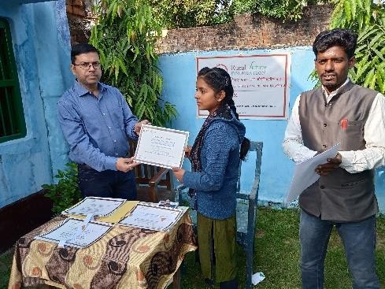
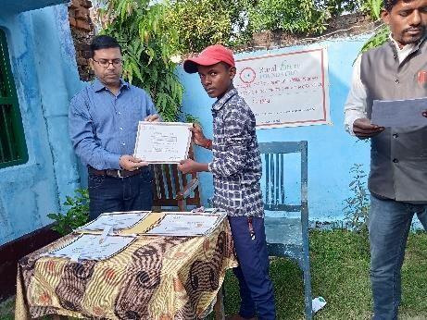
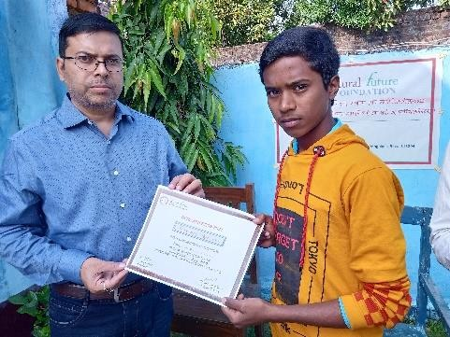
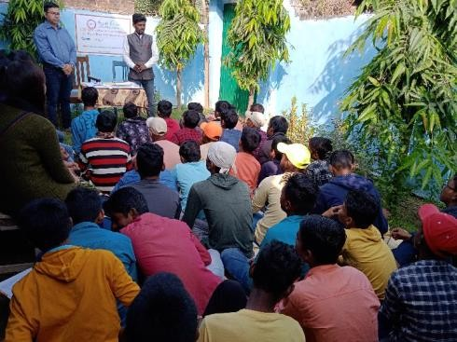
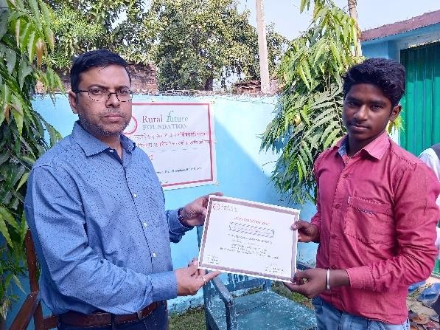
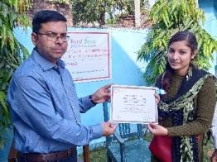
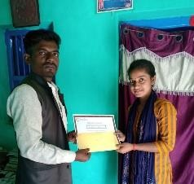
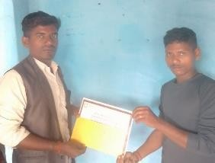
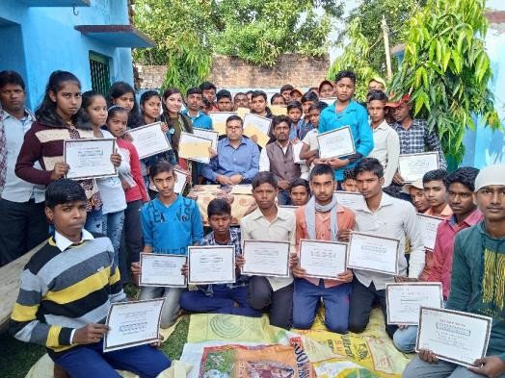
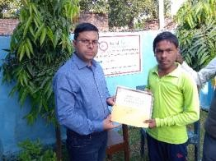
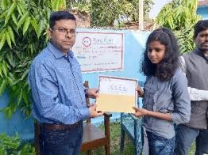
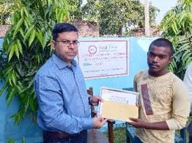
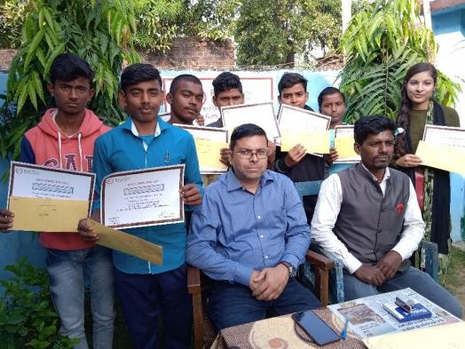
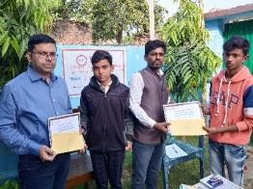
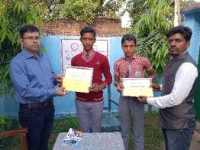
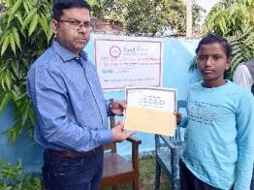
4Rural Quiz 2021 Prize Distribution Ceremony
A prize distribution ceremony was organized on 25th November 2021 at RFF Gram Pustakalay center for all 3 groups i.e. Group A ( Class 11-12), Group B ( Class 9-10) and Group C ( Class 7-8).
Cash Prize of INR 500/- , INR 200/- and INR 100/- along with certificate was given to first, second and third winner of all three group . A part of these winners, participation certificates were given to top 11 students of all group.
Quiz Winner
GROUP A – 1ST WINNER
GROUP A – 2ND WINNER
GROUP A – 3RD WINNER
GROUP B – 1ST WINNER
GROUP B – 2ND WINNER
GROUP B – 3RD WINNER
GROUP C – 1ST WINNER
GROUP C – 2ND WINNER
GROUP C – 3RD WINNER

Slide 9

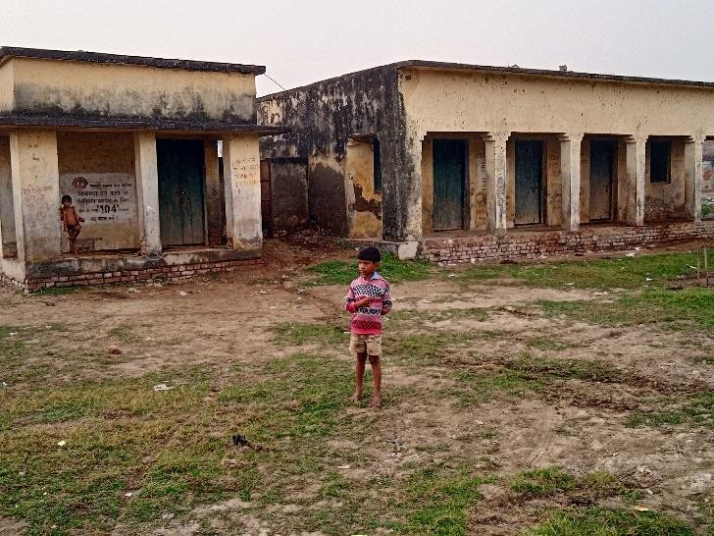
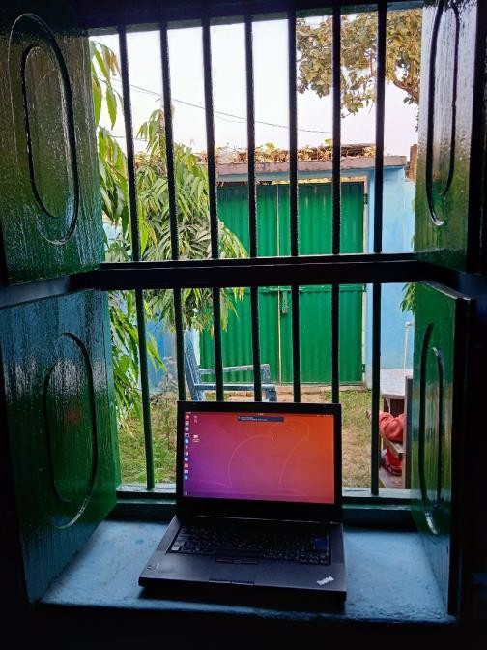
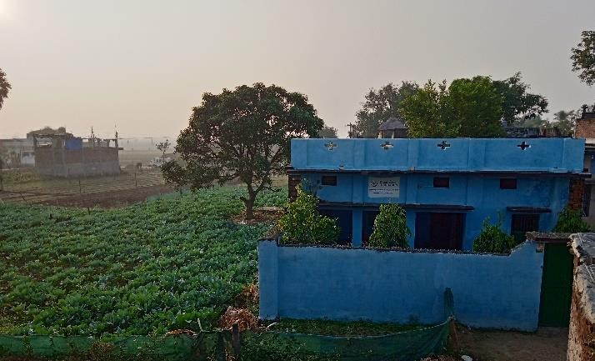
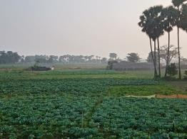
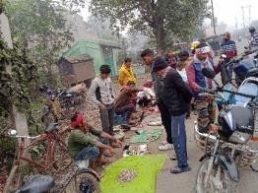


1Health camp for prevalence, Awareness and Control of NCDs
Future Initiatives
Rural Future Foundation has emphasized the importance of health issues especially NCDs in rural population In rural area significant number of population never checked their BP and diabetes .
We will conduct Diabetes and BP screening camp at our Field Operation Office in Ekchari Village for screening, awareness and prevention on regular intervals.
2Smart Classroom
PHC NEaR OUR FIELD OPERaTION OFFICE
Digital methods can make a huge
difference to rural education. Rural Future Foundation is going to establish smart classroom for imparting and accessing quality education in rural India. Rural children have the right to quality education and smart class room will help them to access education and information from voluntarily teacher across the world. The smart classroom will also help to conduct online session for farmers to train them in agriculture related information.
3Rural Tourism Integrated Community Development
A friend from Finland has graciously donated the laptop for the same and we are exploring the resource to make fully digital classroom.
A WINDOW OF OPPORTUNITY
Millions of people from villages and small town have been migrated to big cities and abroad for livelihood and better career opportunity. They are seeking to connect with their rural lives. Our rural campus at Ekchari Village of Bhagalpur District in Bihar is providing Rural Tourism Integrated Community Development, which is located near the excavated of the ancient Vikramshila University.
In this tourism, you get in touch with rural life, enjoy sunrises or sunsets, listen to the birds, look at the stars, art, and culture, interacting with the localities, enjoy local cuisine, visit many unique tourist place as well as involve yourself and your family members in community development especially children.
OUR RURaL CaMPUS
For interacting with rural communities, designing and checking concepts, developing models or just spending some time in minimum basic facilities, we at Rural Future Foundation are happy to host.

Slide 10




Press Coverage
https://www.voiceofbihar.in/bha galpur-library-and-information- center-opened-by-rural-future- foundation-at-rasalpur- ekchari/?fbclid=IwAR2pB1SHS OtZDSpx0p9- gtli7qsLDARf3mw2nP6hjzI- VUUjCNgWT5ntavo
http://reporters24x7.com/230820210935- 2/?fbclid=IwAR3G7lboBkzIsdkPbPGw3JbQNw3ZcM6 nxD1LWiZ3P38FQsW3fHkrfRBpB-A

Slide 11

List of Supporters
We would like to thank all our contributor for their generous support.
Udayraj Verma Uday
Amethi
Amir Anjum
Aligarh
Dr. Ritu Pallavi
Bhopal
Srinivas Vittal
Chennai
Ambika Vishwanath
Gurgaon
Dr. Manoj Mita
Bhagalpur
Shantinath Chaudhary
Hyderabad
Anuj Patel Ekchari
Neeti Agrawal
Rishikesh
Anurag Anand
Purnia
Abhishek Vijaykum ar
Aditya Dubey
Noida
Amarjeet Pandit
Ekchari
Amit Kumar
Ekchari
Diwakar Choudhary
Bhagalpur
Santosh Choudhary
Noida
Roshan Thakur
Madhubani
Rajive Acharya
Finland

Slide 12

Help Us Change Lives
A/C Name-
RURAL FUTURE FOUNDATION
Rural Future Foundation is a non-profit organization . Your donation will be used to fulfill the mission of Rural Future Foundation to provide data driven tech- solutions using best practices to create a replicable model of sustainable development for vulnerable rural population, and improve the lives and living conditions of many in desperate and urgent need of assistance.
Account No –
50200056114170
IFSC Code-
HDFC0005129
Account Type-
Current Account
You may also send Books, Digital Equipment's, library furniture, glucometer etc. at our field operation office.
Bank Name-
HDFC Bank
Bank Branch-
SKY Garden Greater NOIDA
PAN No:
AAETR2399P
Contact Us
Field Operation Office
Vill-Rasalpur, Post-Ekchari, District-Bhagalpur, Bihar-813204
Head Office
C-205, French Apartment, Sector-16B, GH-07B,P.S. Bisrakh, Greater Noida West, U.P.-201308
Registered Office
J-8/105, Second Floor,Rajouri Garden, J-7,New Delhi -110017
Whats App
9871874406
Email
contact@ruralfuture.in : ruralfuturefoundation@gmail.com
Website
www.ruralfuture.in

